Slide 1
Puesta en producción de modelos de aprendizaje automñatico
Presentación con una selección de las slides de las dos primeras presentaciones de Chip Huyen que se pueden consultar en stanford-cs329s.github.io/syllabus.html
Julio Waissman | MCD/Unison | Aprendizaje Automático Aplicado

Slide 2
How to pass data between processes?
Ride
management
Driver management
Need driver availability & price to show riders
Need ride demand & price to incentivize drivers
Price optimization
A simple ride-sharing microservice
Need ride demand & driver availability to set price

Slide 3
Data passing through databases
Ride
management
Driver management
DB, DW
Price optimization
What if processes don’t share database access?
Read & write from databases can be slow

Slide 4
Data passing through services
Ride
management
POST / GET … requests REST / RPC
Driver management
Price optimization
Inter-service communication can blow up

Slide 5
Data passing through brokers
Ride
management
Driver management
Real-time transport
Price optimization

Slide 6
Real-time transport: pubsub
Any service can publish to a stream [producer]
Any service can subscribe to a stream to get info they need [consumer]
from confluent_kafka import Consumer, SerializingProducer
producer = SerializingProducer(producer_config)
producer.produce(
topic=”prediction”,
key=example_id,
value=prediction,
)
pred_consumer = Consumer(consumer_config)
pred_consumer.subscribe([”prediction”])

Slide 7

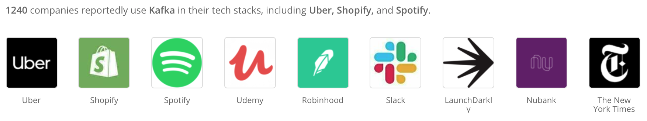
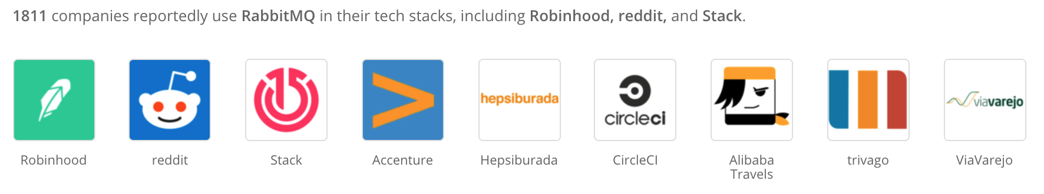

Real-time transport: pubsub, message queue, etc.

Slide 8
Batch processing vs. stream processing
Historical data | Streaming data
Databases, data warehouses | Kafka, Kinesis, Pulsar, etc.
Batch features: age, gender, job, city, income when account was created | Dynamic features locations in the last 10 minutes recent activities
Bounded: know when a job finishes | Unbounded: never finish
Processing kicked of periodically, in batch e.g. MapReduce, Spark | Processing can be kicked off as events arrive e.g. Flink, Samza, Spark Streaming

Slide 9
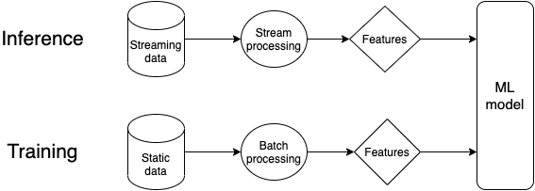
One model, two pipelines
⚠⚠ A common source of errors in production ⚠⚠

Slide 10
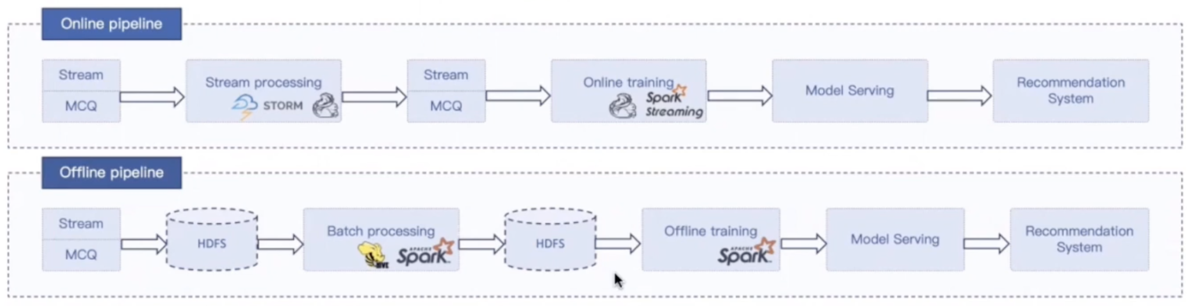
One model, two pipelines: example
Machine learning with Flink in Weibo (Qian Yu, QCon 2019)

Slide 11
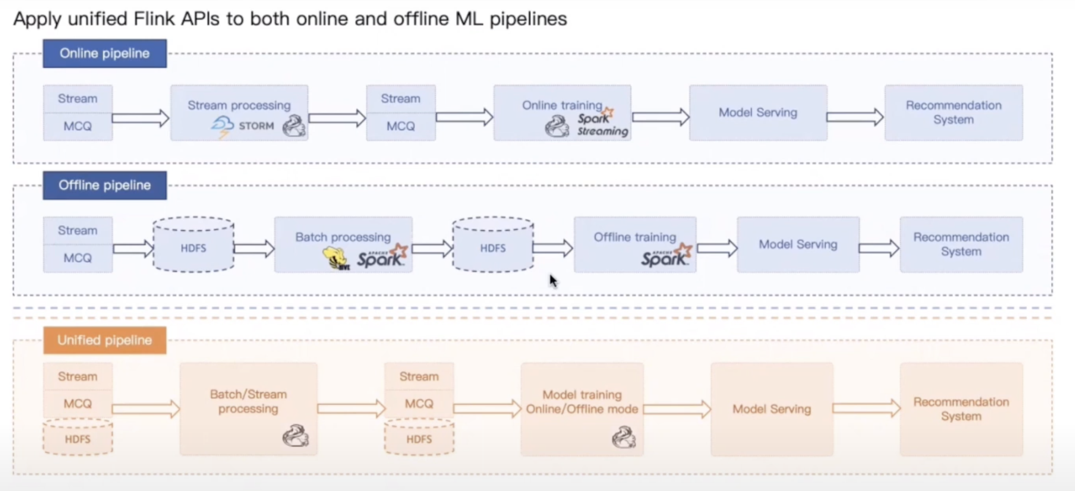
Machine learning with Flink in Weibo (Qian Yu, QCon 2019)

Slide 12
Barriers to stream processing
Companies don’t see the benefits of streaming
Systems not at scale
Batch predictions work fine
Online predictions would work better but they don’t know that

Slide 13
Barriers to stream processing
Companies don’t see the benefits of streaming
High initial investment on infrastructure
Mental shift
Python incompatibility

Slide 14
How to serve your model?
Batch prediction vs. online prediction
Cloud computing vs. edge computing

Slide 15
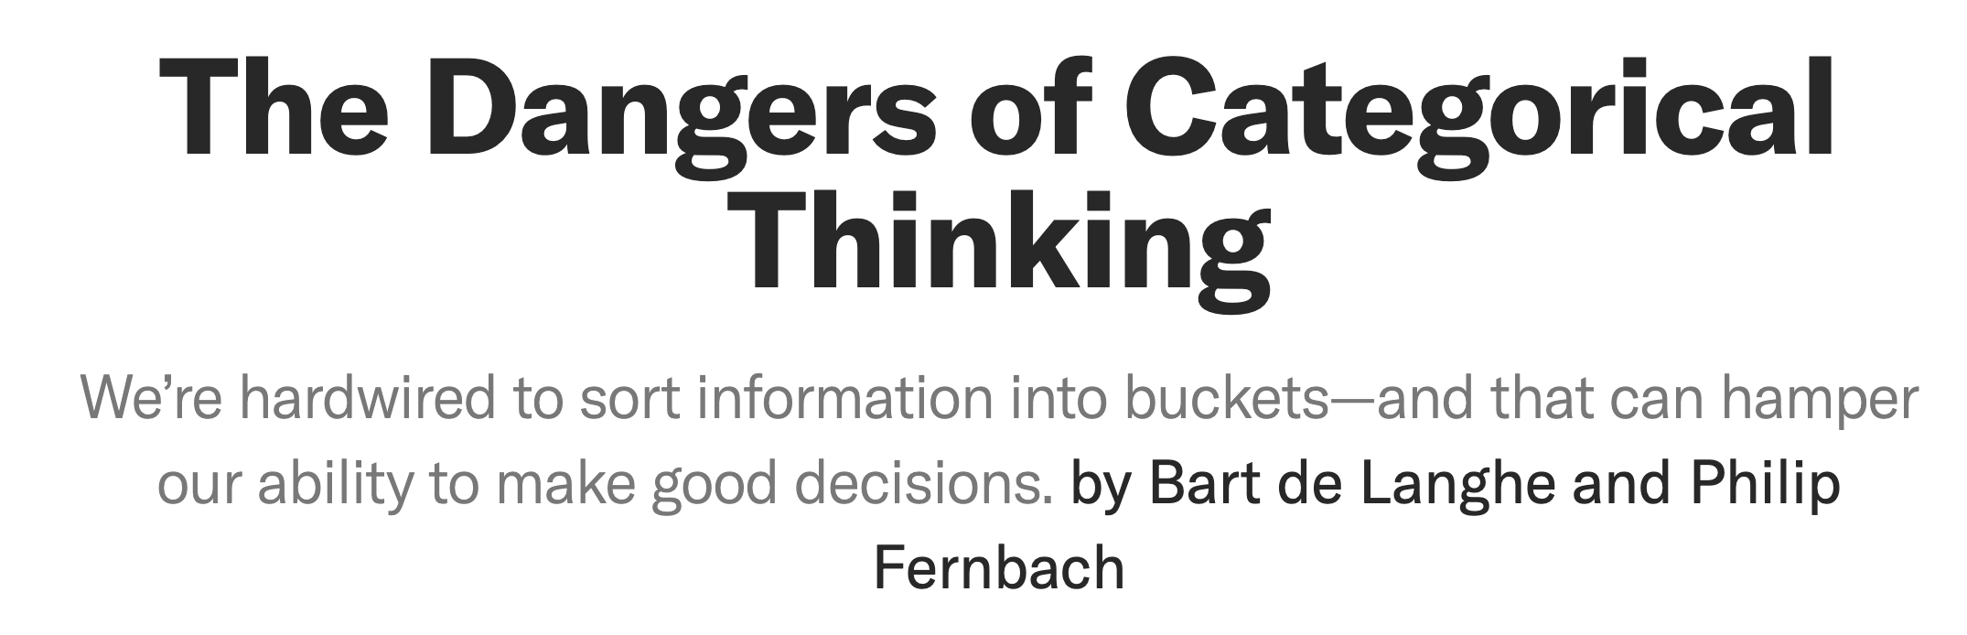
⚠⚠ The dangers of categorical thinking ⚠⚠
Seemingly different ways of doing things might be fundamentally similar
Choices don’t have to be mutually exclusive
Choices can evolve over time

Slide 16
Batch prediction vs. online prediction

Slide 17
Batch prediction vs. online prediction
Batch prediction
Generate predictions periodically before requests arrive
Predictions are stored (e.g. SQL tables) and retrieved when requests arrive
Asynch
Online prediction
Generate predictions after requests arrive
Predictions are returned as responses
Sync when using requests like REST / RPC
HTTP prediction
Async [with low latency) with real-time transports like Kafka / Kinesis
Streaming prediction
Offered by major cloud providers
Still challenging

Slide 18
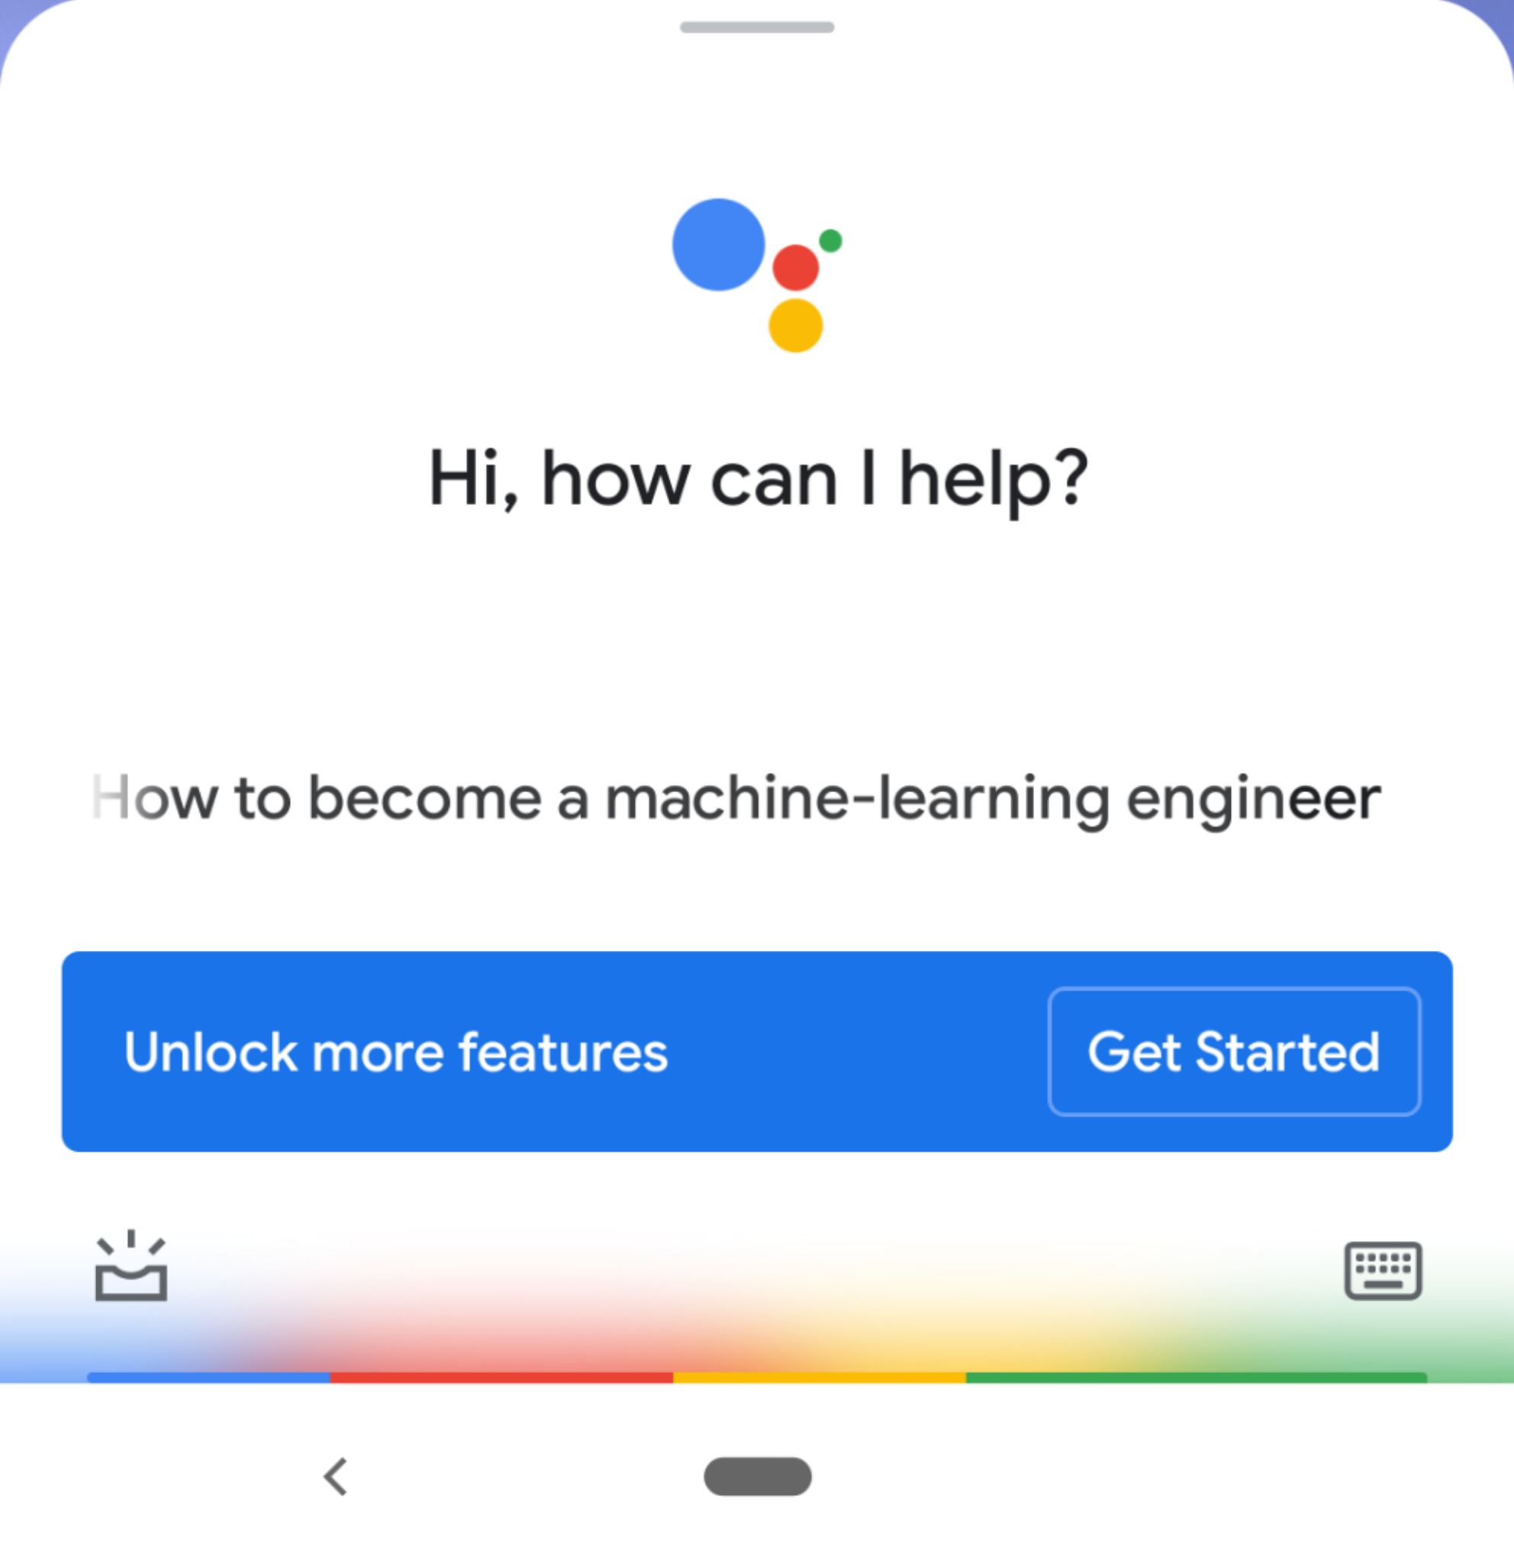

 | Batch prediction (async) | Online prediction (generally sync)
Frequency | Periodical (e.g. every 4 hours) | As soon as requests come
Useful for | Processing accumulated data when you don't need immediate results (e.g. recommendation systems) | When predictions are needed as soon as data sample is generated (e.g. fraud detection)
Optimized | High throughput | Low latency
Input space | Finite: need to know how many predictions to generate | Can be infinite
Examples | TripAdvisor hotel ranking Netflix recommendations | Google Assistant speech recognition Twitter feed

Slide 19


Hybrid: batch & online prediction
Online prediction is default, but common queries are precomputed and stored
Restaurant recommendations use batch predictions
Within each restaurant, item recommendations use online predictions
Title recommendations use batch predictions
Row orders use online predictions

Slide 20
Cloud computing vs. edge computing

Slide 21
 | Cloud computing | Edge computing
Computations | Done on cloud (servers) | Done on edge devices (browsers, phones, tablets, laptops, smart watches, activity watchers, cars, etc.)
Examples | Most queries to Alexa, Siri, Google Assistant Google Translate for rare language pairs (e.g. English - Yiddish) | Wake words for Alexa, Siri, Google Assistant Google Translate for popular language pairs (e.g. English - Spanish) Predictive text Unlocking with fingerprints, faces

Slide 22
Benefits of edge computing
Can work without (Internet) connections or with unreliable connections
Many companies have strict no-Internet policy
Caveat: devices are capable of doing computations but apps need external information
e.g. ETA needs external real-time traffic information to work well

Slide 23
Benefits of edge computing
Can work without (Internet) connections or with unreliable connections
Many companies have strict no-Internet policy
Caveat: devices are capable of doing computations but apps need external information
e.g. ETA needs external real-time traffic information to work well
Don’t have to worry about network latency
Network latency might be a bigger problem than inference latency
Many use cases are impossible with network latency
e.g. predictive texting

Slide 24
Benefits of edge computing
Can work without (Internet) connections or with unreliable connections
Many companies have strict no-Internet policy
Caveat: devices are capable of doing computations but apps need external information
e.g. ETA needs external real-time traffic information to work well
Don’t have to worry about network latency
Network latency might be a bigger problem than inference latency
Many use cases are impossible with network latency
e.g. predictive texting
Fewer concerns about privacy
Don’t have to send user data over networks (which can be intercepted)
Cloud database breaches can affect many people
Easier to comply with regulations (e.g. GDPR)
Caveat: edge computing might make it easier to steal user data by just taking the device

Slide 25
Benefits of edge computing
Can work without (Internet) connections or with unreliable connections
Many companies have strict no-Internet policy
Caveat: devices are capable of doing computations but apps need external information
e.g. ETA needs external real-time traffic information to work well
Don’t have to worry about network latency
Network latency might be a bigger problem than inference latency
Many use cases are impossible with network latency
e.g. predictive texting
Fewer concerns about privacy
Don’t have to send user data over networks (which can be intercepted)
Cloud database breaches can affect many people
Easier to comply with regulations (e.g. GDPR)
Caveat: edge computing might make it easier to steal user data by just taking the device
Cheaper
The more computations we can push to the edge, the less we have to pay for servers

Slide 26
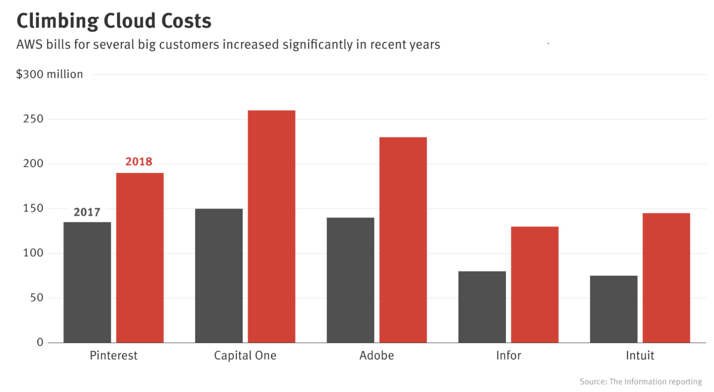
A cloud mistake can bankrupt your startup!

Slide 27
Hybrid
Common predictions are precomputed and stored on device
Local data centers: e.g. each warehouse has its own server rack
Predictions are generated on cloud and cached on device

Slide 28
Challenges of ML on the edge
Hardware: Make hardware more powerful
Model compression: Make models smaller
Model optimization: Make models faster

Slide 29
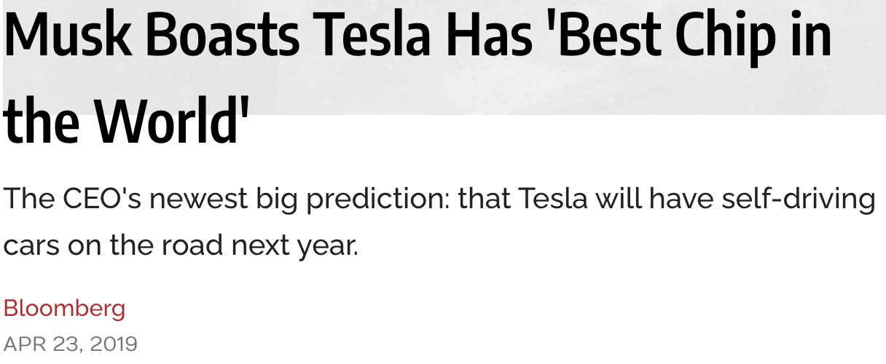
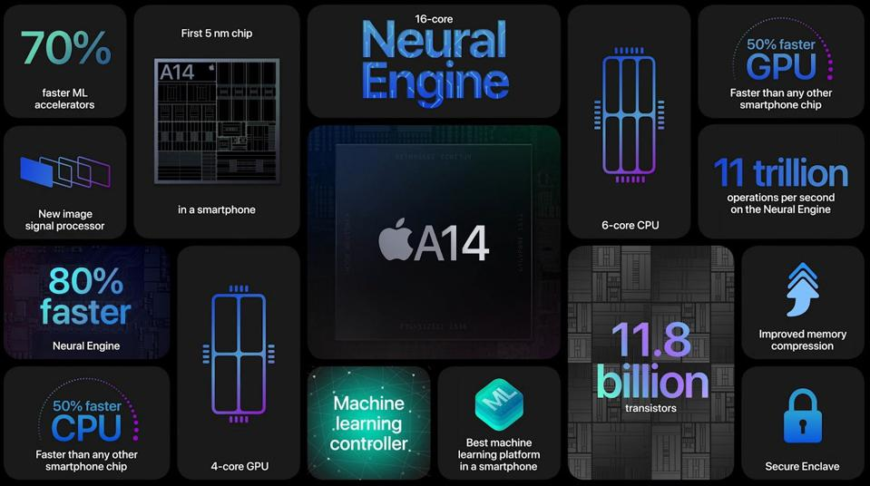
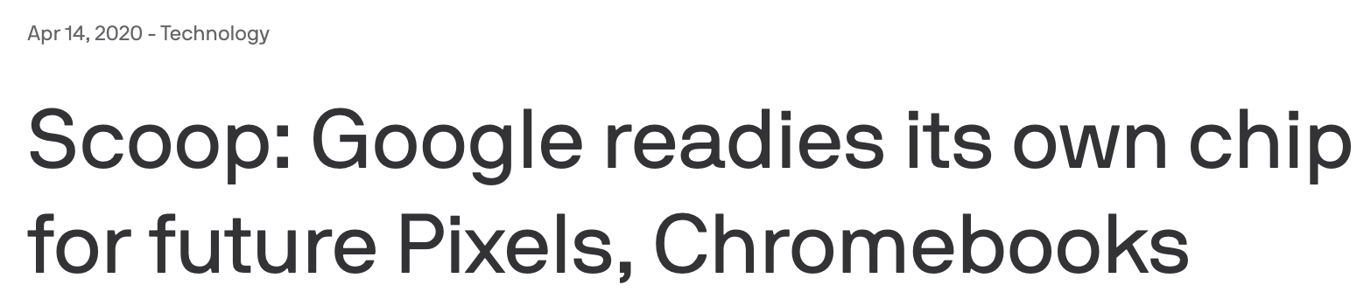
Make hardware more powerful: big companies
⚠ unreliable narrator ⚠

Slide 30
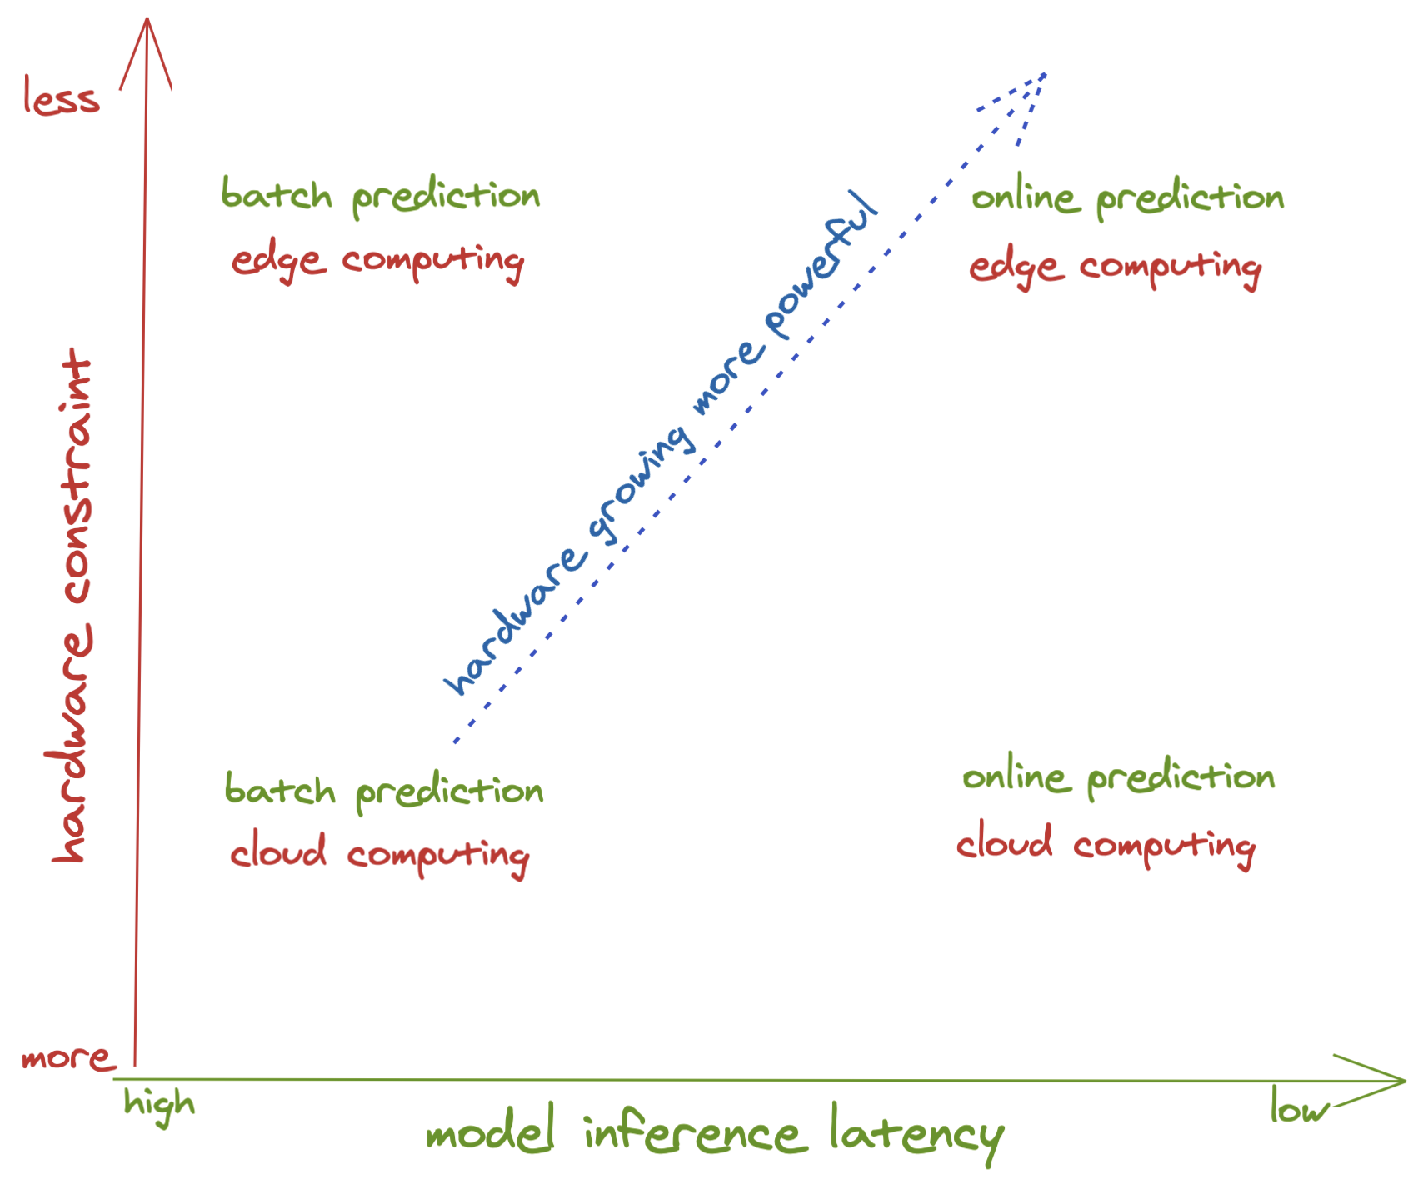



Future of ML: online and on-device
Notes:
Likely examples: step counting

Slide 31
Model Compression

Slide 32
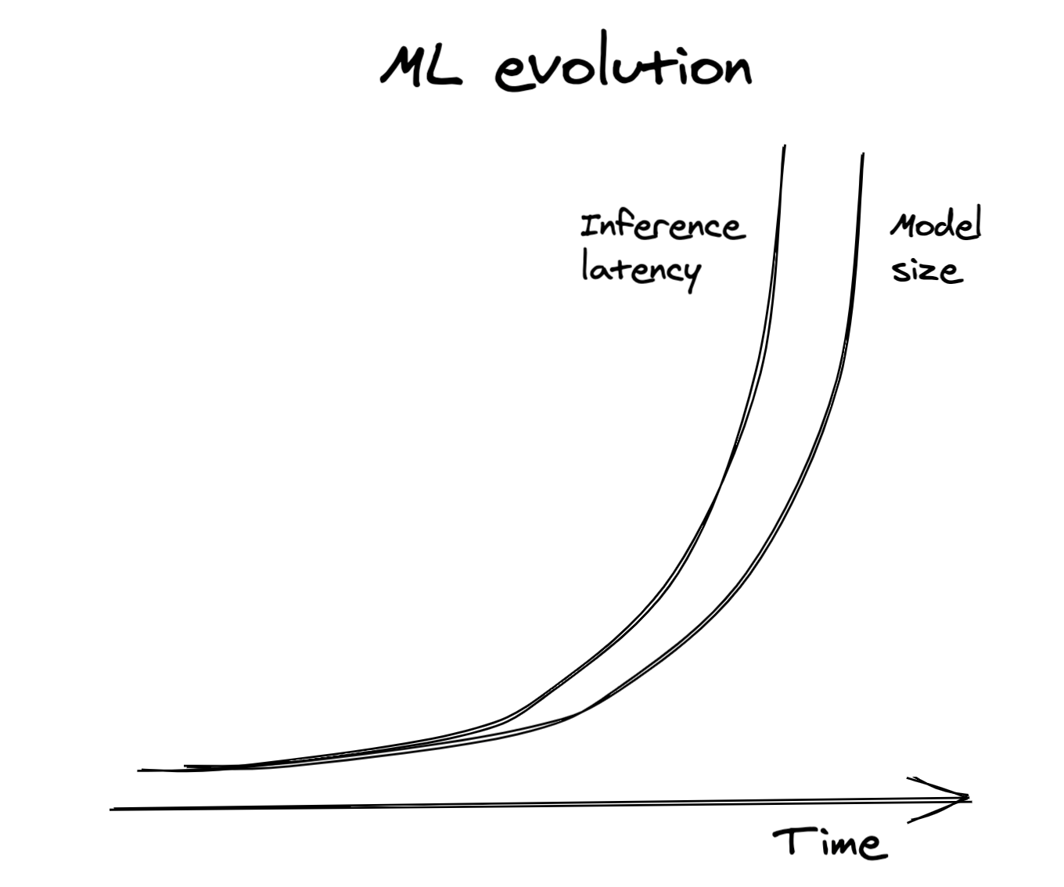
Bigger, better, slower

Slide 33
Model compression
Quantization
Knowledge distillation
Pruning
Low-ranked factorization

Slide 34
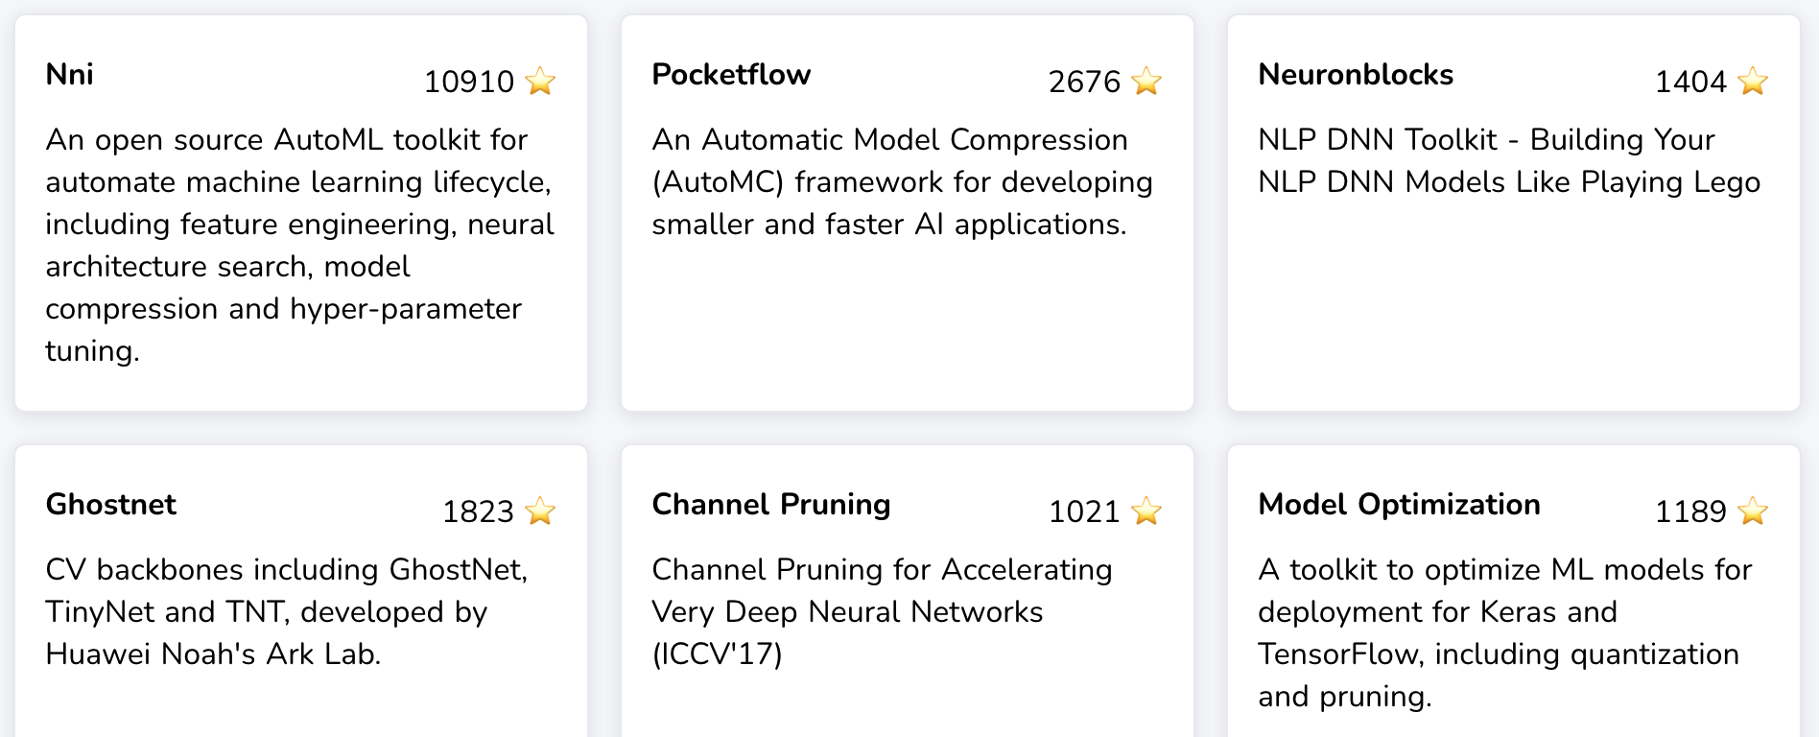
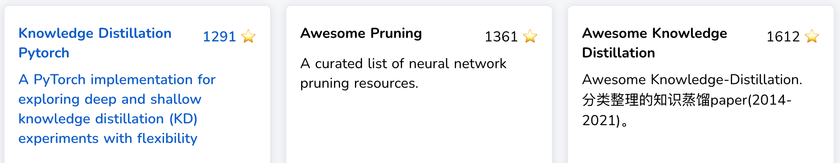
Model compression: active research/development
https://opensourcelibs.com/libs/model-compression | https://awesomeopensource.com/projects/model-compression

Slide 35
Model compression: quantization
Reduces the size of a model by using fewer bits to represent parameter values
E.g. half-precision (16-bit) or integer (8-bit) instead of full-precision (32-bit)
100M params
32-bit 400MB
16-bit 200MB

Slide 36
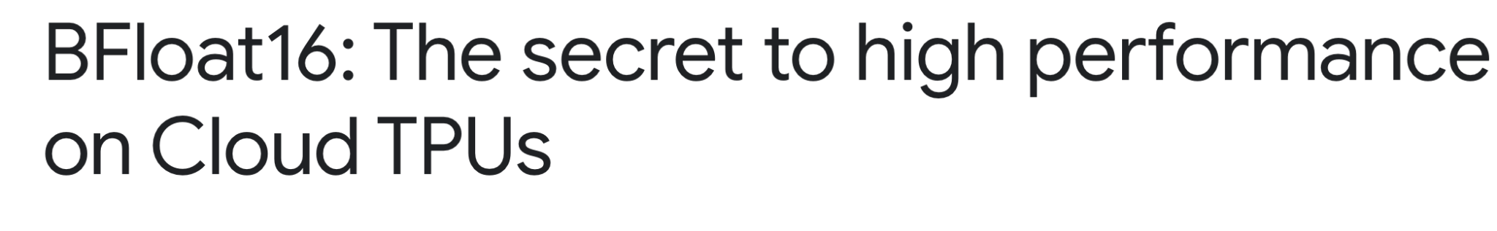
Model compression: quantization
Pros | Cons
Reduce memory footprint Increase computation speed Bigger batch size Computation on 16 bits is faster than on 32 bits | Smaller range of values Values rounded to 0
Need efficient rounding/scaling techniques

Slide 37
Model compression: knowledge distillation
Train a small model (“student”) to mimic the results of a larger model (“teacher”)
Teacher & student can be trained at the same time.
E.g. DistillBERT, reduces size of BERT by 40%, and increases inference speed by 60%, while retaining 97% language understanding.
DistilBERT, a distilled version of BERT: smaller, faster, cheaper and lighter (Sanh et al., 2019)

Slide 38
Model compression: knowledge distillation
Train a small model (“student”) to mimic the results of a larger model (“teacher”)
Pros:
Fast to train student network if teacher is pre-trained.
Teacher and student can be completely different architectures.
Cons:
If teacher is not pre-trained, may need more data & time to first train teacher.
Sensitive to applications and model architectures.

Slide 39
Model compression: pruning
Originally used for decision trees to remove uncritical sections
Neural networks: reducing over-parameterization

Slide 40
Model compression: pruning methods
Remove nodes
Changing architectures & reducing number of params

Slide 41
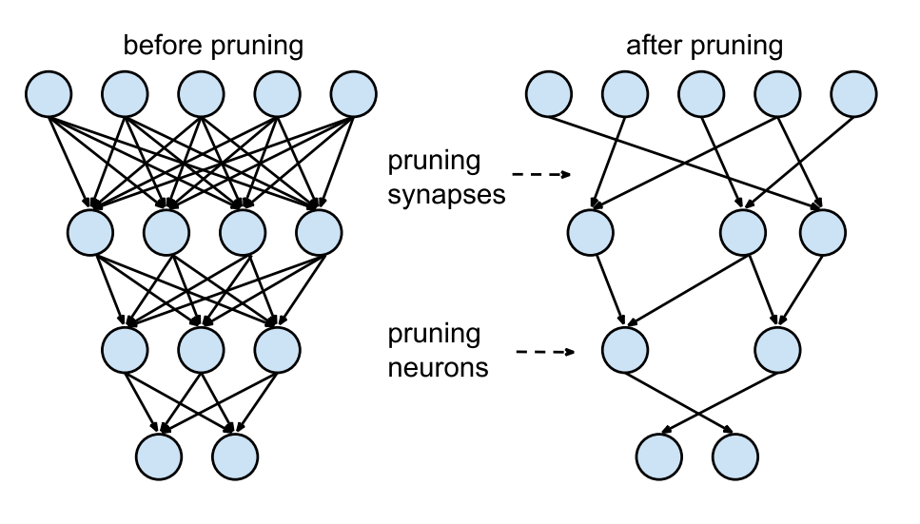
Model compression: pruning methods
Remove nodes
Find least useful params & set to 0
Number of params remains the same
Reducing number of non-zero params
Learning both Weights and Connections for Efficient Neural Networks (Han et al., 2015)

Slide 42
Model compression: pruning methods
Remove nodes
Find least useful params & set to 0
Number of params remains the same
Reducing number of non-zero params
???
Learning both Weights and Connections for Efficient Neural Networks (Han et al., 2015)

Slide 43
Model compression: pruning methods
Remove nodes
Find least useful params & set to 0
Number of params remains the same
Reducing number of non-zero params
Makes models more sparse
lower memory footprint
increased inference speed
The Lottery Ticket Hypothesis: Finding Sparse, Trainable Neural Networks (Frankle et al., ICLR 2019)

Slide 44
Model compression: pruning methods
Remove nodes
Find least useful params & set to 0
Number of params remains the same
Reducing number of non-zero params
Can be used for architecture search

Slide 45
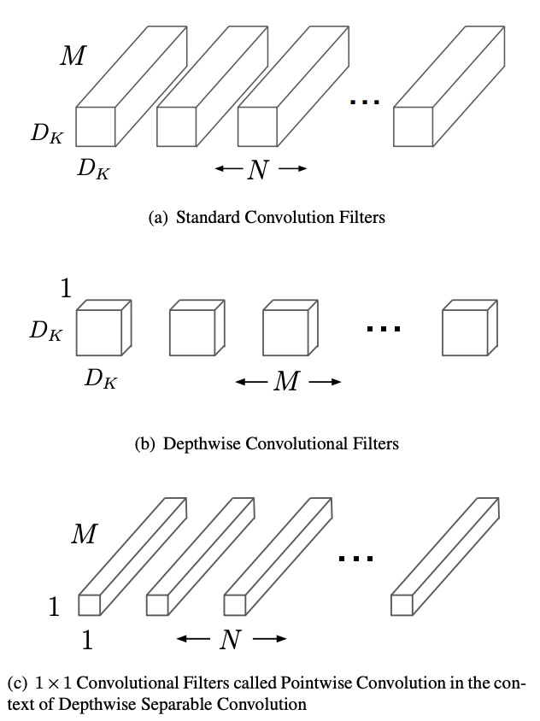
Model compression: factorization
3 x 3 matrix can be written as a product of 3 x 1 and 1 x 3
6 params instead of 9
Replace convolution filters (many parameters) with compact blocks
E.g. MobileNets:
(a) are replaced by depthwise convolution
(b) and pointwise convolution
(c) to build a depthwise separable filter
MobileNets: Efficient Convolutional Neural Networks for Mobile Vision Applications (Howard et al., 2017)

Slide 46
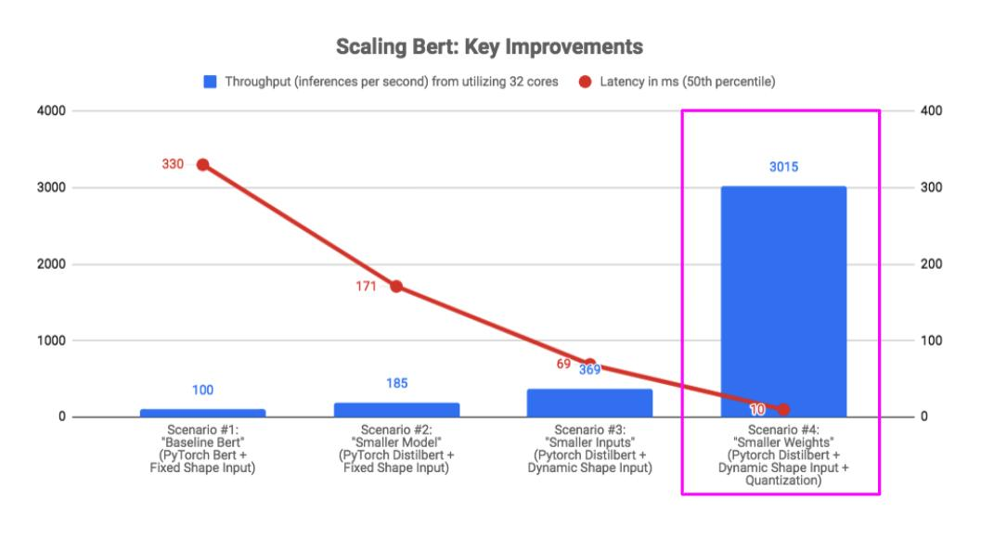
Make models smaller: case study
How We Scaled Bert To Serve 1+ Billion Daily Requests on CPUs (Roblox, 2020)

Slide 47
Compiling & optimizing models for edge devices

Slide 48
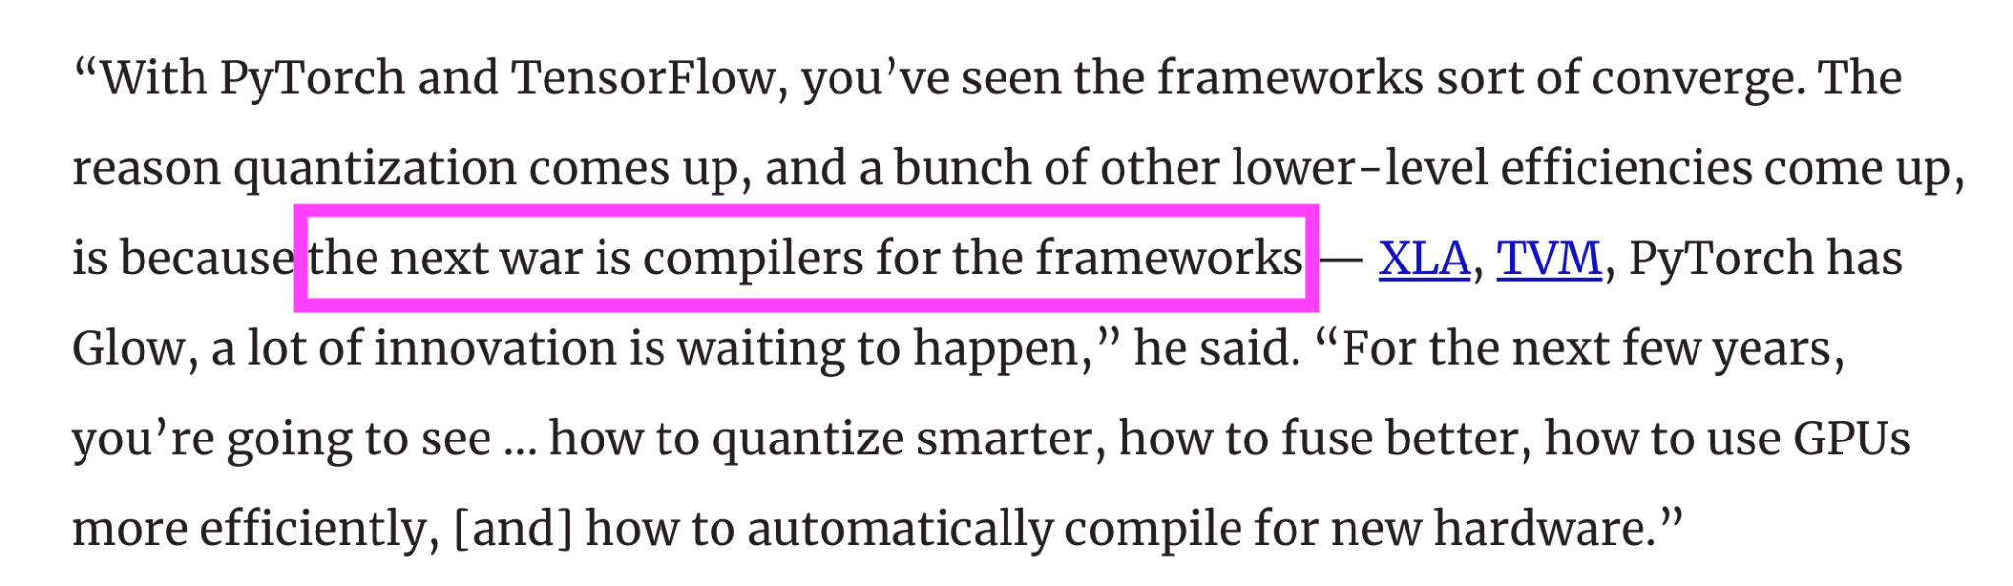
Soumith Chintala, creator of PyTorch (VentureBeat, 2020)

